Slide 1

Lip Reading for Urdu Counting Using MobileNet
By ABUBAKAR

Slide 2
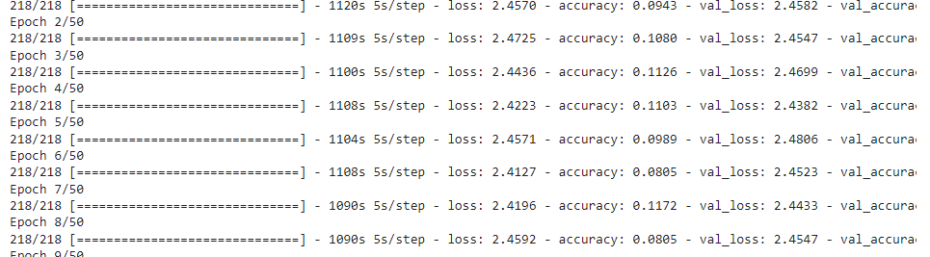
LAST WEEK WORK
*COLLECTED DATA ✔
*TRAINED MODEL USING MOBILENET ✔
ACCURACY 18 % ✔

Slide 3
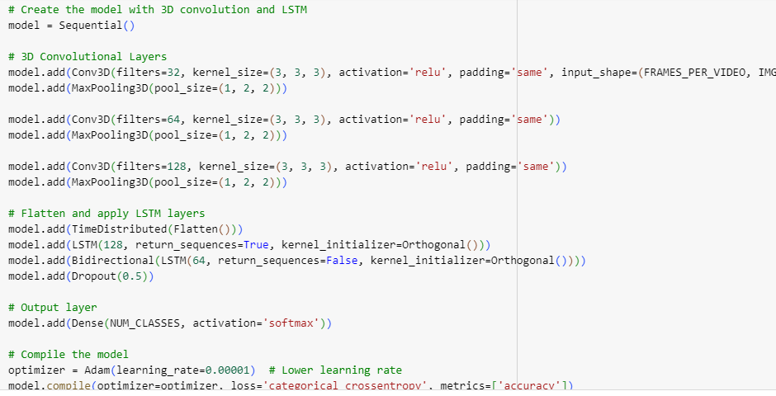
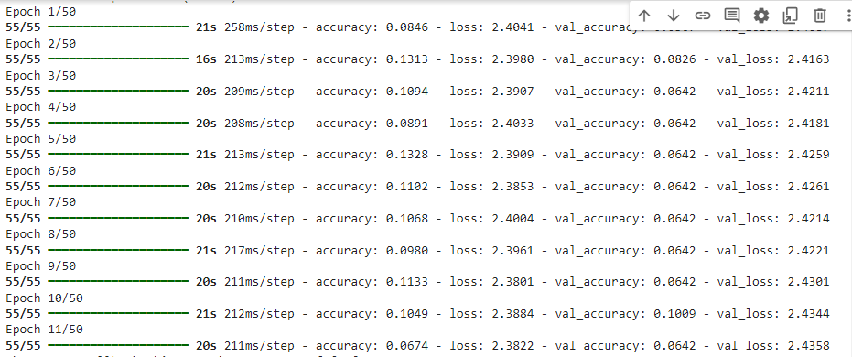
THIS WEEK WORK
* used model with 3D convolution and LSTM✔

Slide 4
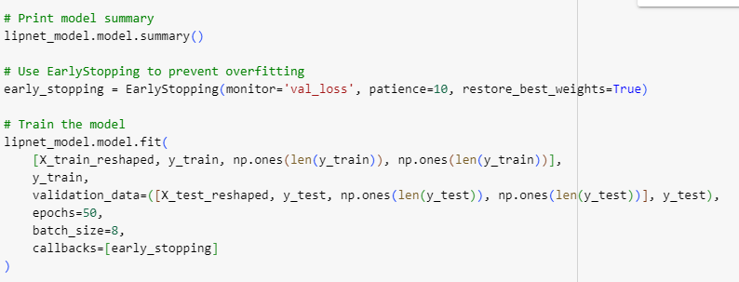
Tried LIPNET model but accuracy was low

Slide 5
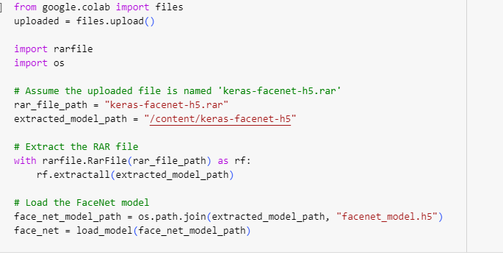
Now trying keras-facenet

Slide 6
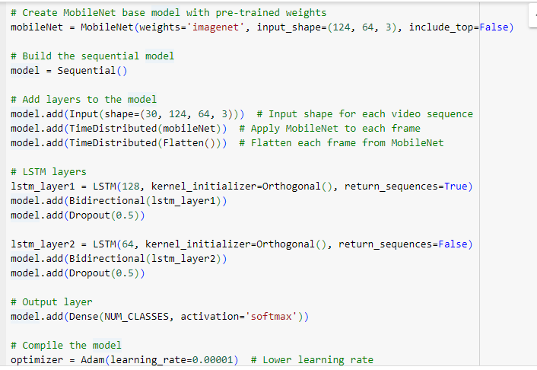
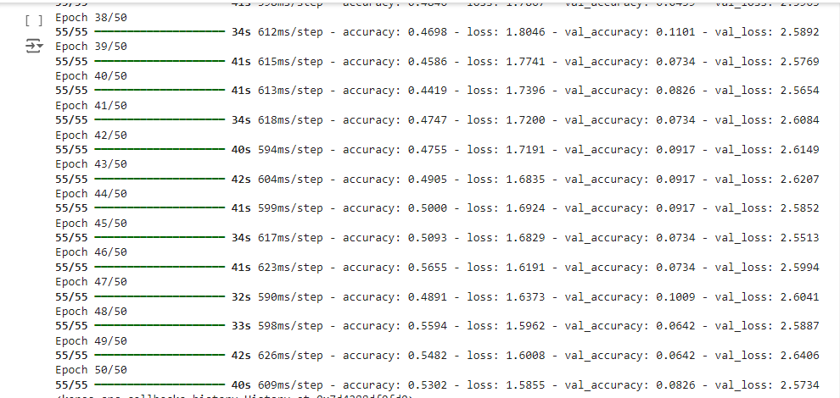
MobileNet base model with pre-trained image weights got max accuracy till 55%

Slide 7
This week… *improve 55% accuracy from 18%✔
*applied data augmentation ✔
*tkinter app ✔
overleaf work ✔

